Slide 1
Future learning Goals
STUDENTS NAME : A.UMA MAHESWARI
REGISTER AN NIMD : 24131131802522019/asanm11324131131802522019
DEPARTMENT : BSC.CPOMPUTER SCIENCE
COLLEGE : 113-VALLALAR ART’S AND SCIENCE COLLEGE
COLLEGE : NNAMALAI UNIVERSITY

Slide 2
PROJECT TITLE
FUTURE LEARNING GOALS

Slide 3
FUTURE LEARNING GOALS
AGENDA:
☆INTRODUCTION
☆WHY FUTURE LEARNING GOAL MATTER
☆EXAMPLE FUTURE LEARNING GOALS
☆HOW TO SET EFFECTIVE LEARNING GOALS
☆STRATEGIES TO ACHIEVE LEARNING GOALS
☆CONCLUSION

Slide 4
INTRODUCTION
In a constantly evolving world, continous learning is essential for personal and professional growth
This topic explones the importance of settings learning goals ,specific areas top focus on and strategies to achieve them.

Slide 5
Why FUTURE LEARNING GOALS MATTER
(*) ADAPTABILITY
☆Learning new skills helps adapt to changing Industries and technologies.
(*) PERSONAL GROWTH
☆promotes intellectual development, critical thinking, and self awareness.
(*)CAREER ADVANCEMENT
☆Enhance Qualification opening up new opportunities.

Slide 6
EXAMPLE FUTURE LEARNING GOALS
(♡) ACADEMIC GOALS
● Complete a degree or certification
●Improve performance in a particular subject
●Learning a new language
(♡)PROFESSIONAL GOALS
●Gain skills relevant to a chosen career
●Obtain industry specific certifications
●Improve leadership or communication skills

Slide 7
STRATEGIES TO ACHIEVE LEARNING GOALS
《》 Create a learning schedule or timeline
《》 Join study group’s or conversation
《》 Seek feedback and mentorship

Slide 8
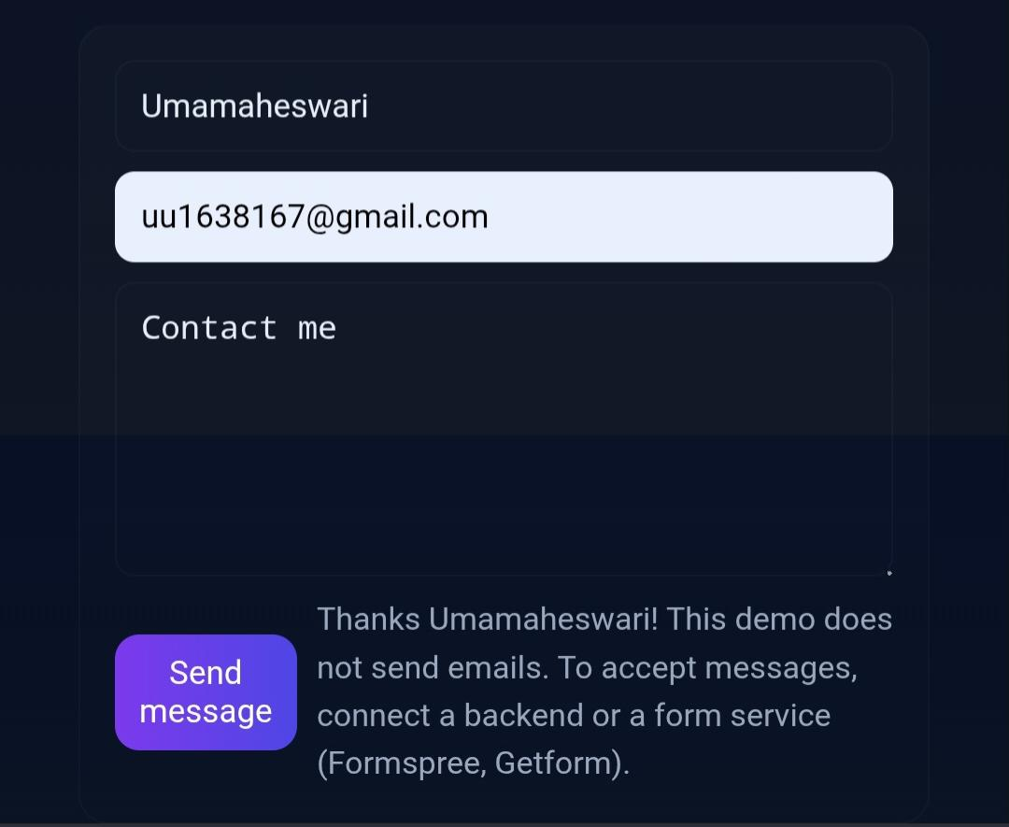
HOW TO SET EFFECTIVE LEARNING GOALS

Slide 9
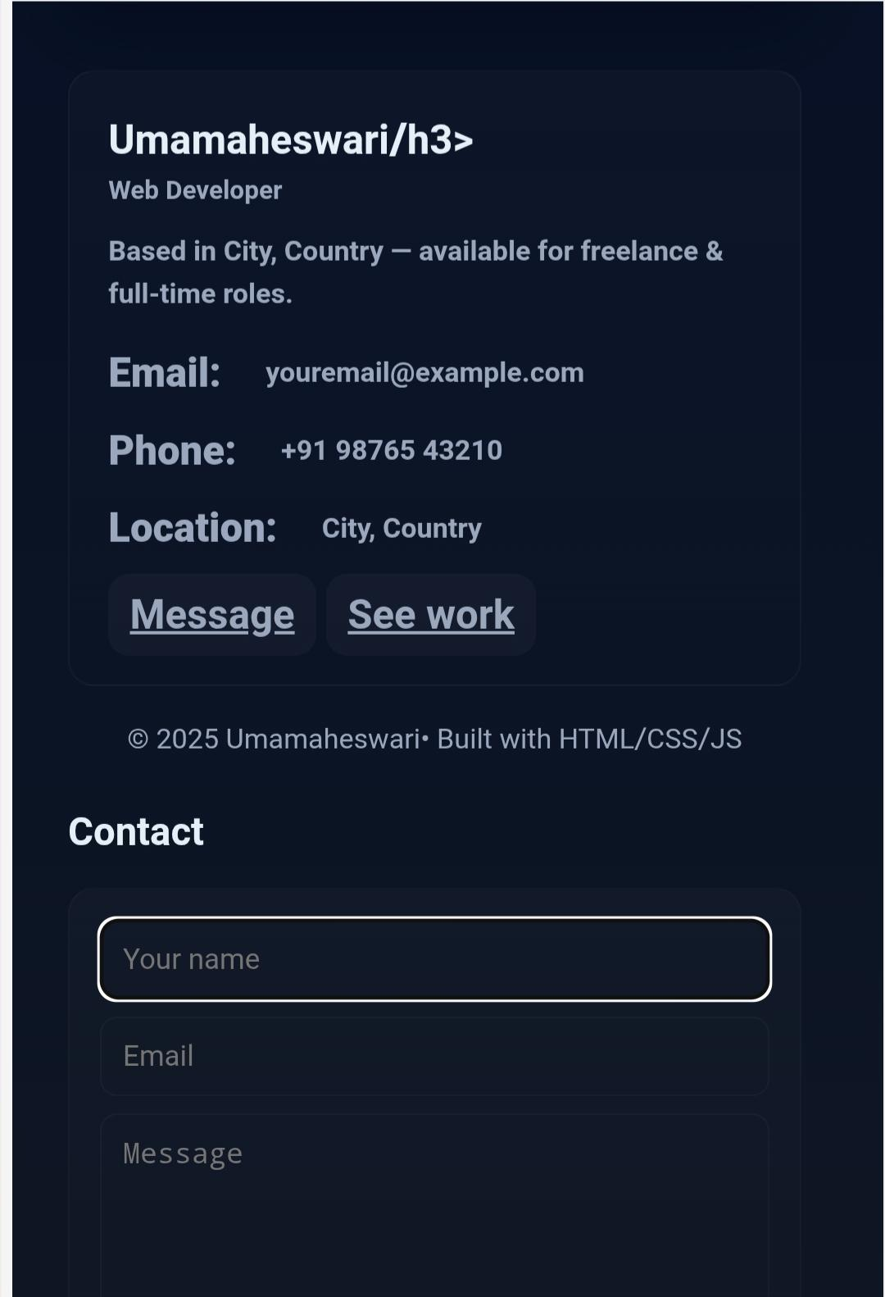
HOW TO SET EFFECTIVE LEARNING GOALS

Slide 10
CONCLUSION
Future learning goals are not just about gaining knowledge ,but about shaping the person you want to be come.

